Slide 1
Team 24 Proposal Presentation
Phased Array GPR Simulations
Daniel Miller
Tyler Castro
Michael Turner
Coy Coburn

Slide 2
GPR Block Diagram
Control Unit
Objective: To map underground root systems
The transmitter will pulse a signal to penetrate the ground.
The receiver will take the reflected signal.
The control unit will display the created radar image and record an image log.
The main feature of this GPR system is the phased array antennas.
Transmitter Antenna
Receiver Antenna
Direct Signal
Transmitted Pulse
Reflected Pulse
Buried Object

Slide 3
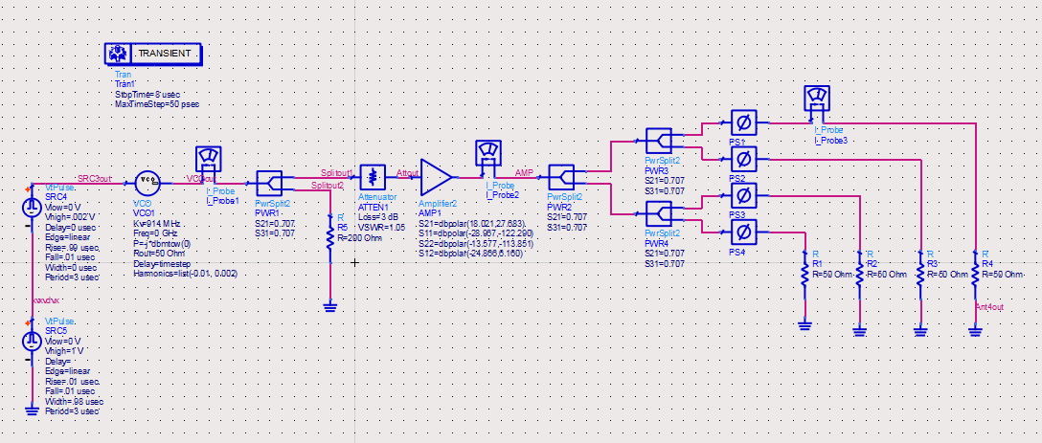
Transmitting Antenna

Slide 4
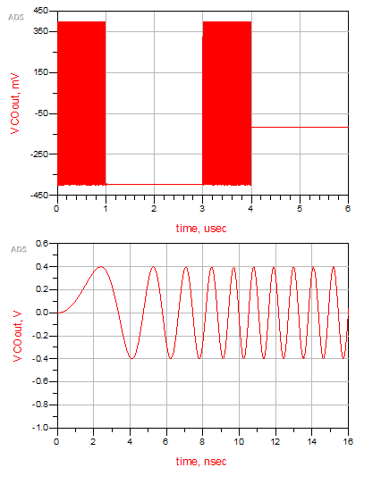
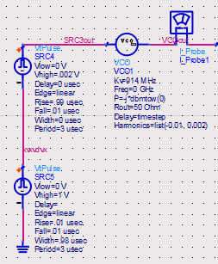
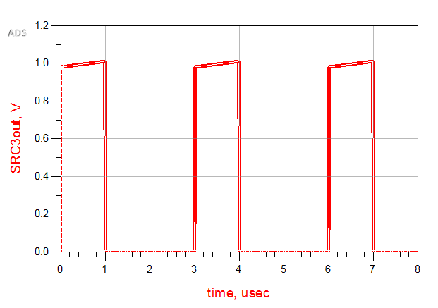
Chirp Generator
Chirp example
Input signal into the VCO

Slide 5
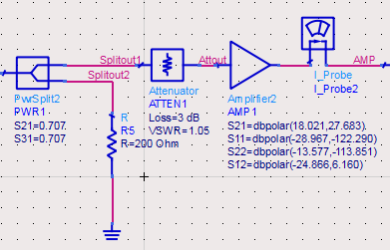
Splitter, Attenuator, Amplifier
Splitter for sending to a mixer on the receiving end
Attenuator for keeping a low VSWR
Amplifier S-parameters based off of an LNA of 11 dB gain, ZX60-3011+

Slide 6
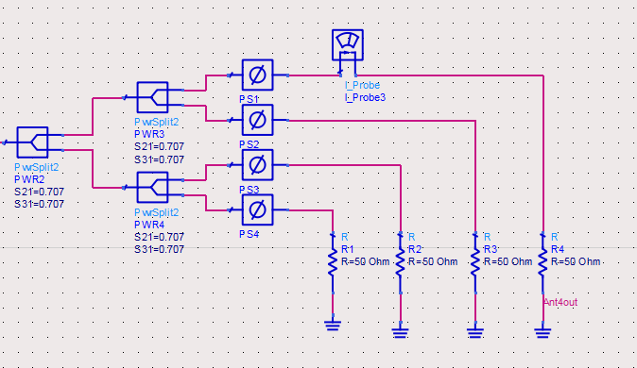
Antenna Array with Phase Shifters
50 ohm resistors used to represent antenna load
Phase shifters used to direct or focus antenna pattern

Slide 7
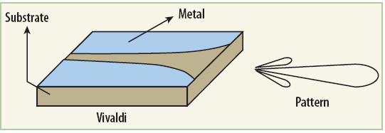
Antenna Type
Vivaldi antenna
Directive
Low-cost
Able to be constructed, if necessary
Frequency dependent on construction

Slide 8
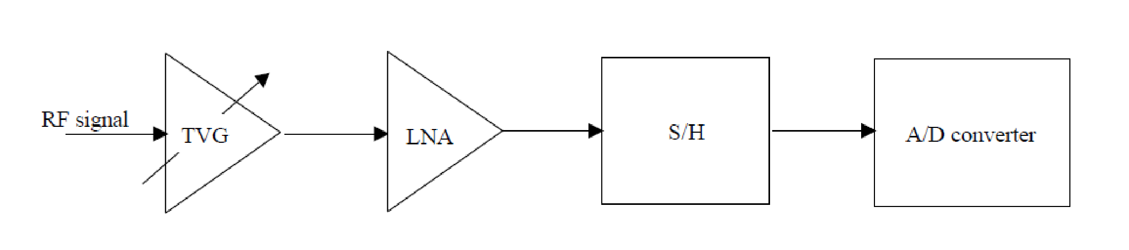
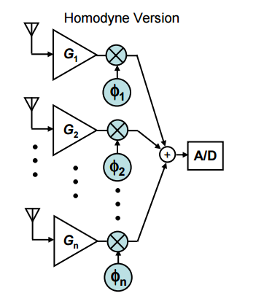
Receiver Block Diagram
The receiver picks up the reflected signals.
We chose the Homodyne version over the Heterodyne phased array to avoid the need to utilize multiple LO with each incoming signal.
We want to amplify before mixing samples so we do not lose any reflections.
The four main blocks that make up this circuit are the TVG, LNA, SH, and ADC

Slide 9
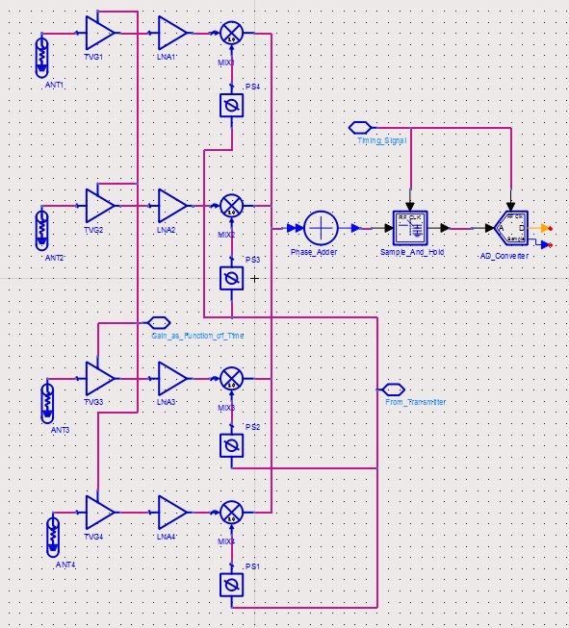
Circuit Implementation
We decided to implement a passive array due to cost restraints.
The TVG is included before the LNA so that its design can be much more sensitive without saturation of the air and ground.
Overall, this increases the dynamic range of the receiver.

Slide 10
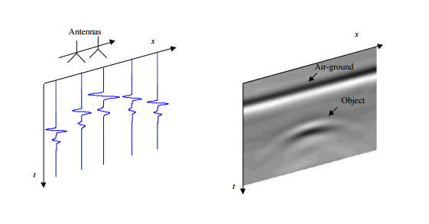
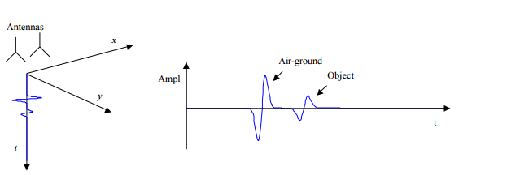
Radar Display
Below are examples of the expected signals to be received. The first example is a basic signal, while the second one is the reflection from multiple signals.

Slide 11
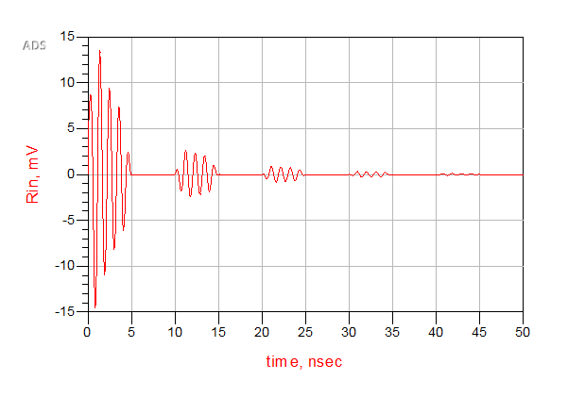
Receiver test signal
This test signal is made by pulsing a decaying sine wave.
This is due to the farther away an object is, the weaker the reflected signal will be.
The medium (ground) usually does not return much reflection after entering the ground.

Slide 12
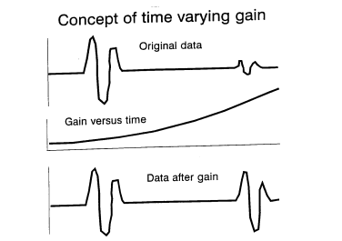
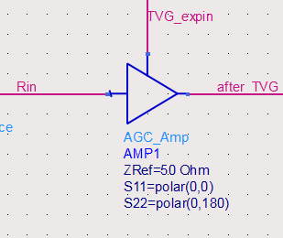
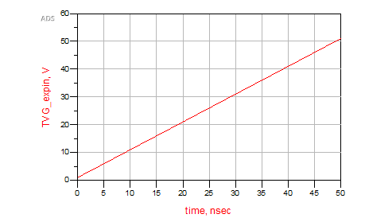
Time Varying Gain
Farther distance = weaker reflection
Therefore, a time varying gain is needed to compensate for the signal. In theory, all reflections should be of the same amplitude.
TVG is very similar to the Automatic Gain Control

Slide 13
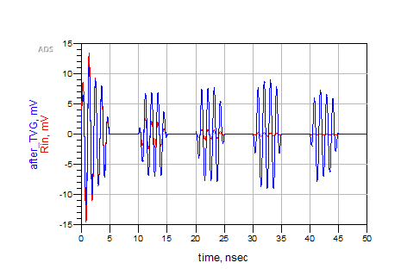
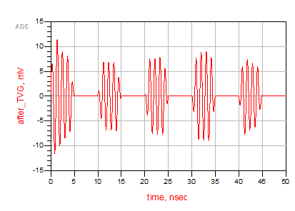
TVG output
While the TVG test does amplify the reflected signals, it needs to be uniform. The TVG function will need to be tweaked depending on the decay rate.

Slide 14
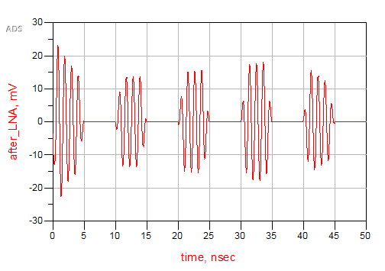
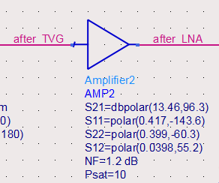
Low Noise Amplifier
The LNA’s purpose is to get full use of the RF’s dynamic range.
With the LNA following the TVG, it can now be much more sensitive without saturating the reflections.
Simulation S values were found from a transceiver BFP 420 datasheet, for up to 10 GHz

Slide 15
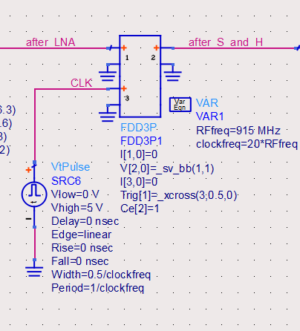
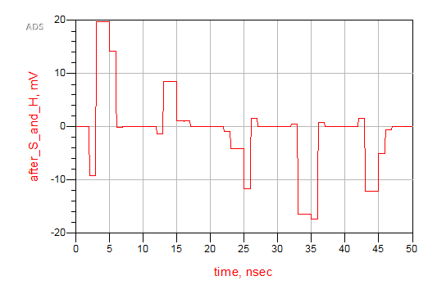
Sample and Hold
Our SH circuit takes samples from the outgoing LNA signal in reference to the rising edge of its given CLK signal.
The clock is usually based on the transmitter’s timing. We will need to match this in later versions
Overall, it slows down the sampling rate for the Ad converter

Slide 16
THANKS AND GIG EM
Questions?

Slide 17
Backup slides
Antenna shielding
SH circuit diagram
Active vs passive array

Slide 18
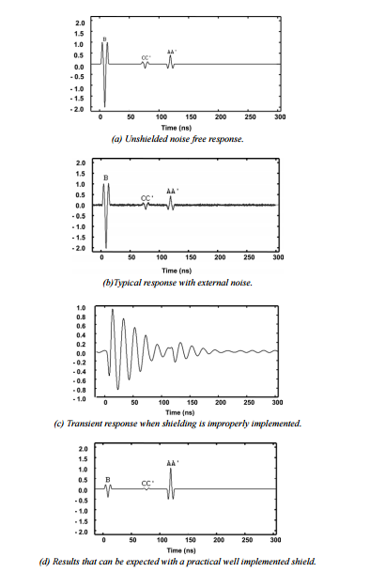

Slide 19
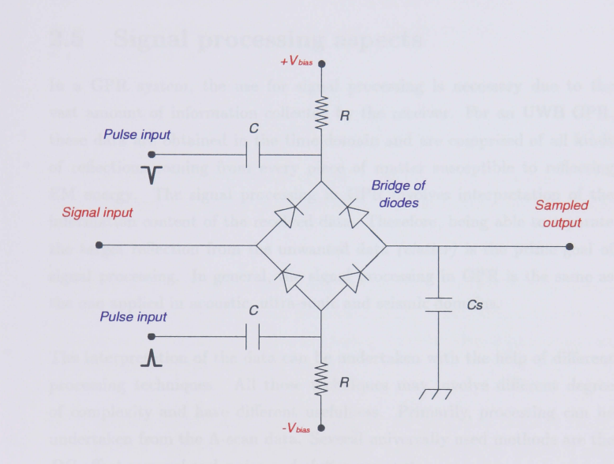
Full bridge SH, used for under 1 GHz

Slide 20
Passive phased arrays have a central transmitter and receiver, with phase shifters located at each radiating element or subarray. The passive array is the least expensive phased array because of its low number and cost of components1 . Active arrays use Transmit/Receive (T/R) modules to provide the last stage of amplification for transmitted signals, the first stage of amplification for receive signals, and provide both amplitude and phase control at each radiating element. The use of T/R modules in active arrays provides the advantages of amplitude control, low loss, and graceful degradation over passive arrays. Given these advantages, one could assume that all phased arrays in development are active.

Slide 21
The noise figure is the difference in decibels (dB) between the noise output of the actual receiver to the noise output of an “ideal” receiver with the same overall gain and bandwidth when the receivers are connected to matched sources at the standard noise temperature T₀ (usually 290 K).

Slide 22
Older adc cannot handle conversion rates of 200 MHz for 8 bit and 10 MHz for 16 conversions. However, newer models may have built SH already in their circuits.

